Slide 1
AWS Multi account governance
Service used for this is AWS control tower
To create and manage multiple acct through one point.
It also implement policies for the account.
Eg : each account for each team.

Slide 2
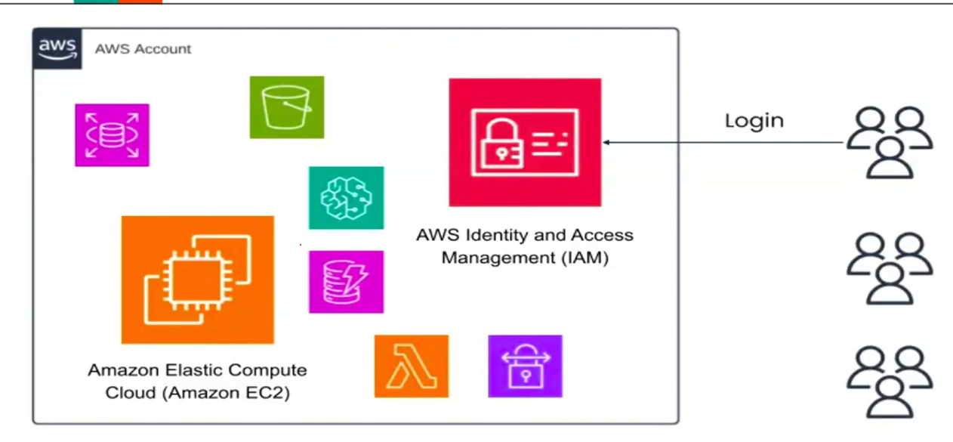
How it is without AWS control tower ?
* Everyone was Directly accessing their AWS resources through I am login.

Slide 3
Problems in earlier setup
Every team are under same aws account, so everyone can see each others resources.
Unstructured management.
No separation between the teams resources
Very difficult to manage all resources under one account.
Difficult to calculate billing for individual teams.
Security Risk
Quota limit for single aws account

Slide 4
Solution: AWS organisation
Multiple aws account → managed centrally.
Account managements and billing tracking easy and budget.

Slide 5
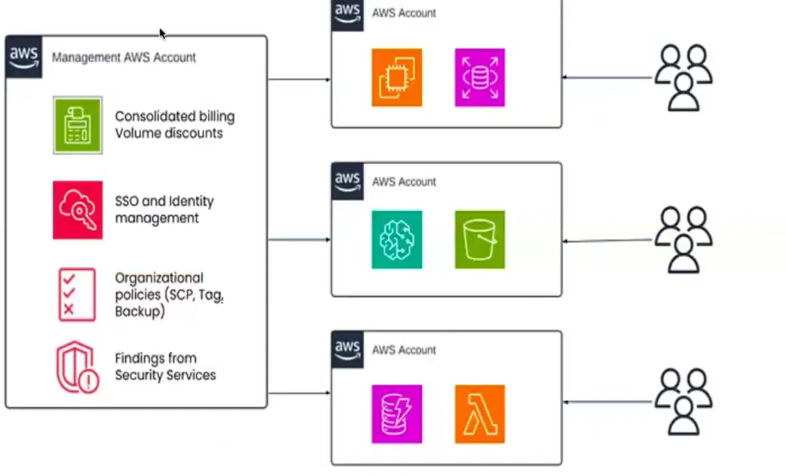
AWS Organisation

Slide 6
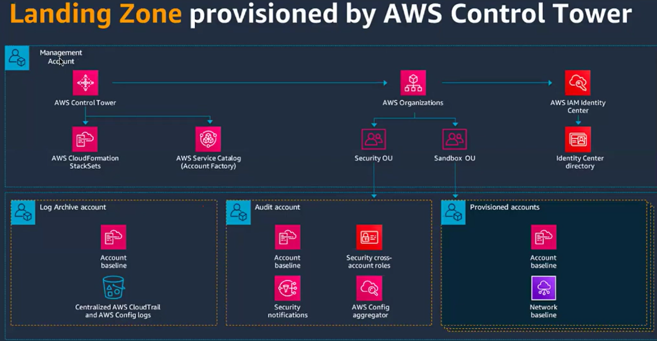
Control tower

Slide 7
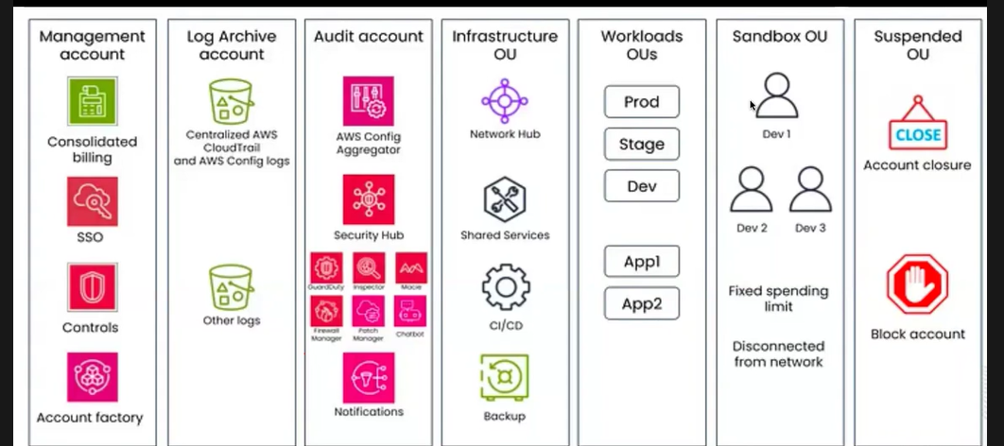
Overall account structure
- Log archive account. (under security OU)
Audit Account.

Slide 8
SCP – Service control policies
Scenario : we have 3 devlopers and we want them to
- Access only RDS and DynamoDB in 5 aws account.
- Prevent all users(even admins) from using EC2 across the organisation.

